Slide 1
Game gazettes
By Tebogo Phosa
Endinaso Tidolo
Charmaine Chikengezha

Slide 2
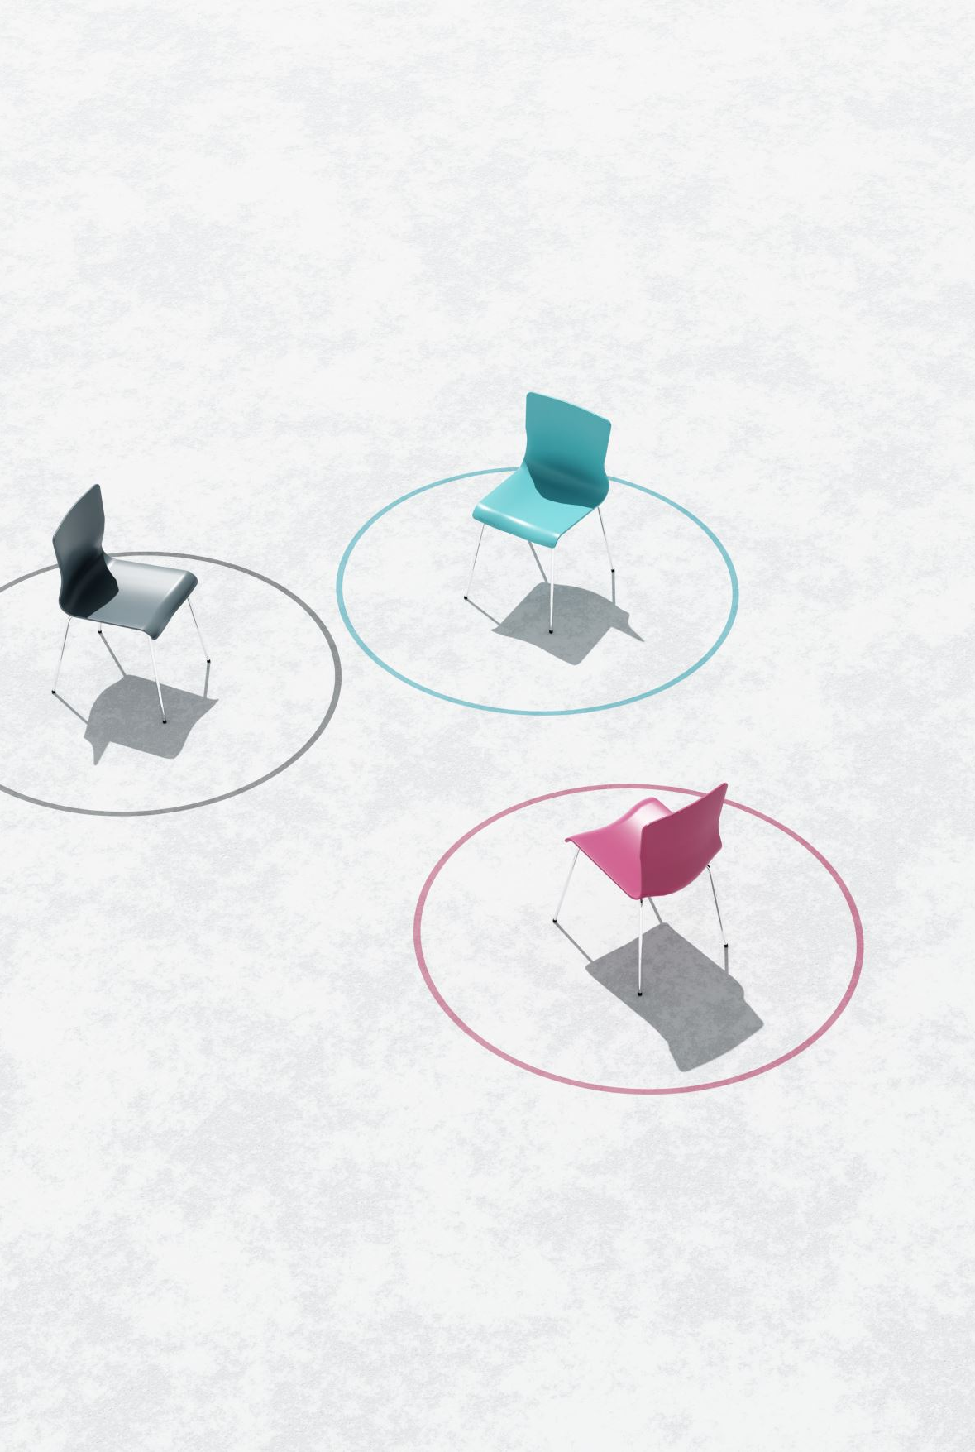
Overview
Roles
Implementation
The Design
The Games
Visual Guide
Challenges
What we have learned

Slide 3
ROLES
Tebogo
Brick Breaker
Key listener for the arrows to move the paddle and managing GitHub.
Snake
The snake and food generation.
Endinaso
Brick Breaker
Creating the paddle and the ball
Snake
Creating the board of the game
Charmaine
Brick Breaker
Creating the bricks and making them appear & disappear when hit by the ball.
Snake
Implementing the action listener.

Slide 4
Implementation
The player controls the snake that grows longer as it eats the apple.
The game ends if the snake runs Into the wall or itsself.
Key Classes:
SnakeGame : MainGame class to initialize the game.
GamePanel: Handles game rendering and updates.
GameFrame: Frame where the game runs.

Slide 5
Implementation
The game is won by clearing all the bricks.
The game is lost if the ball touches the bottom of the screen.
Key Classes:
BrickBreakerGame: Main Game class to initialize the game
GamePanel: Handles the rendering and the game updates.

Slide 6
The Design for Brick Breaker
GamePlay
-play: Boolean -score: int -TotalBricks: int -timer: Timer -delay: int -playerX: int -ballPosX: int -ballPosY: int -ballXdir: int -ballYdir: int -map: MapGenerator
+GamePlay() +paint(g: Graphics): void +actionPerformed(e: ActionEvent): void +KeyPressed(e: KeyEvent): void +moveRight(): void +moveLeft(): void
MapGenerator
+map[][]: int +brickWidth: int +brickHeight: int
+MapGenerator(row, col: int) +draw(g: Graphics2D): void +setBrickValue(value, row, col: int): void
Brickbreaker
+main (String[] args): void

Slide 7
The Design for Snake
GamePanelll
+width: int +height: int +UNIT_SIZE: int +NUMBER_OF_UNITS: int +DELAY: int +x[]: int +y[]: int +length: int +FoodEaten: int +FoodX: int +FoodY: int +direction: char +running: Boolean
GamePanelll() +play(): void +paintComponent(graphics: Graphics): void +draw(graphics: Graphics): void +move(): void +checkFood(): void +addFood(): void +checkHit(): void +gameOver(graphics: Graphics): void +actionPerformed(arg0: ActionEvent): void
GameFrame
GameFrame()
SnakeGame
+main(String[] args): void

Slide 8
How to play the games Brick Breaker
The player control the paddle with the arrow keys.
The ball bounces off the paddle, destroying the bricks.
Each brick has a value point.
Game ends when all the bricks are cleared or if the ball is lost.

Slide 9
How to play the Game Snake
The snake moves horizontally or vertically, one cell at a time.
The player controls the snake using the arrow keys.
The snake must eat the apples to increase the length of the snake and the score.
The games ends when the snake collides with walls or with itself.

Slide 10
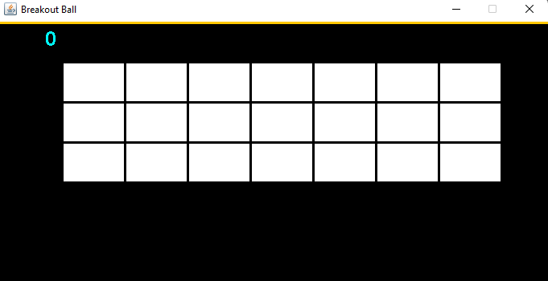
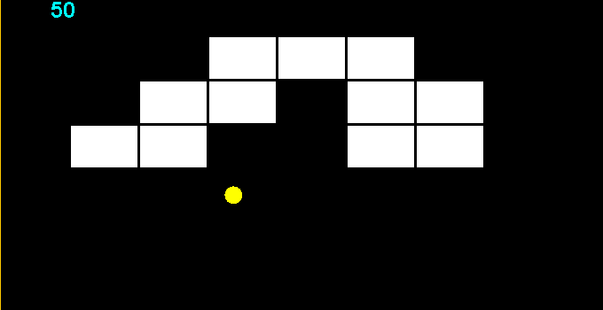
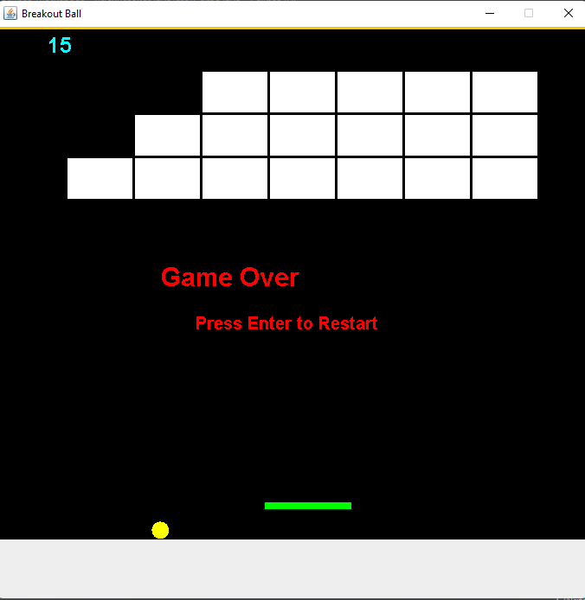
Visual Guide
At start the bricks are intact & the ball & the paddle are in place
As the player bounces the ball on the paddle the score increases & as the ball hits the bricks they disappear.
If the player clears all the bricks the board will display a message and give the give the option to restart.
If the player loses the ball, the board will display a message & the option to restart the game

Slide 11
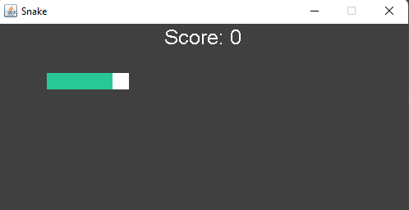
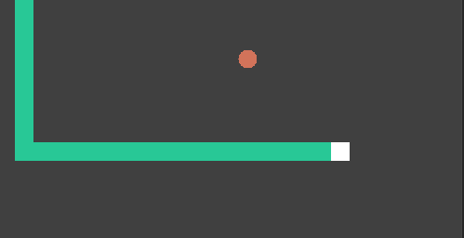
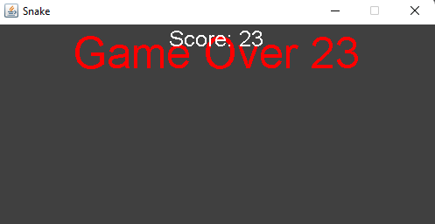
Visual Guide
As the game starts the score is zero and the snake is not that long.
As the player eats the apples the snake increases its length & the score increases
If the player collides with the wall or with the body of the snake, the games will display a message ” GAME OVER”.

Slide 12

Challenges
Uploading files on GitHub.
Time management
Making the ball.
Moving the paddle.
Creating the bricks & making them appear on the board
Key listener for the arrows.
Making the snake grow every time it eats an apple.
Randomly generating the apple on board.

Slide 13
What we have learned
Time management
Error handling & Debugging.
Java specific libraries and framework.
Creating classes for game entities

